Slide 1



TuneIn: How to get your jobs tuned while sleeping
Manoj Kumar
Arpan Agrawal
Pralabh Kumar
Senior Software Engineer
LinkedIn
Software Engineer
LinkedIn
Senior Software Engineer
LinkedIn
To change the background image…
Select the desired background from the “layout” drop-down menu located under the “home” toolbar
To change the speaker picture, right-click on the photo and select ”change picture…”...
Go back to Picture Format tab in the top navigation
Select Crop Tool, go to the drop down menu and select Mask to Shape or Crop to Shape (Depending on what version PowerPoint you have)
Next, select circle shape under Basic Shapes

Slide 2

Our VISION
Create economic opportunity for every member of the global workforce

Slide 3
Our MISSION
Connect the world’s professionals to make them more productive and successful

Slide 4
Agenda
Why TuneIn?
How does TuneIn work?
Architecture and framework features
Road ahead

Slide 5
Grid Scale at LinkedIn
2008​ | 2018​
1 cluster​ | 10+ clusters​
20 nodes​ | 1000s of nodes​
5 users​ | 1000s of active users​
MapReduce​ | Pig, Hive, Spark, etc.​
Few workflows​ | 10000s workflows​

Slide 6

Typical Conversations
Hey, this Spark job is running slowly.
I will tune it to improve the run time.
Manager
Developer

Slide 7
Typical Conversations
We have found some jobs which are consuming high resources on the cluster.
I will ask my team to tune those jobs to reduce the resource usage.
Hadoop Admin
Manager

Slide 8
Typical Conversations
Is there a way we can get this daily report 30 minutes early?
I will try to tune it to reduce the run time.
Client
Developer

Slide 9
Why Tuning?
Optimal parameter configuration:
  leads to better cluster utilization and thus savings
  reduces the execution time
Default configuration is not always optimal

Slide 10
Manual Tuning
PHASE 3
Come up with next parameter set
PHASE 1
Execute
Job
Manual Tuning Process
PHASE 2
Observe the Execution Metrics

Slide 11
Dr. Elephant: Heuristic based tuning
Suggests tuning recommendations based on pre-defined heuristics
No need to worry about the hundreds of counters and parameters
Relies on user’s initiative to use the recommendations
Expects some user expertise
PHASE 3
Come up with next parameter set
PHASE 1
Execute
Job
Heuristics Based Manual Tuning
PHASE 2
Look at the Dr. Elephant recommendations

Slide 12
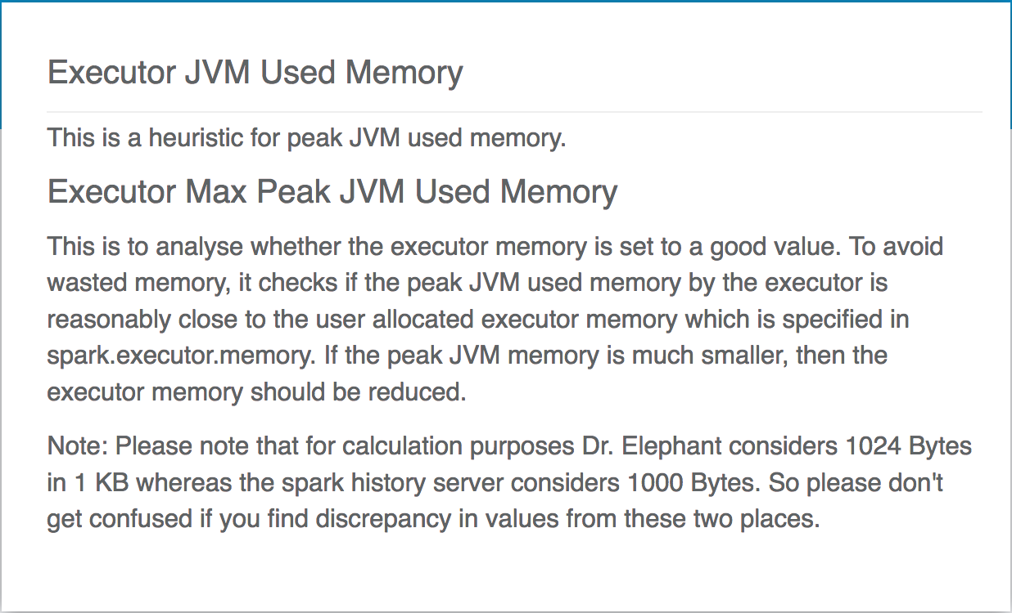
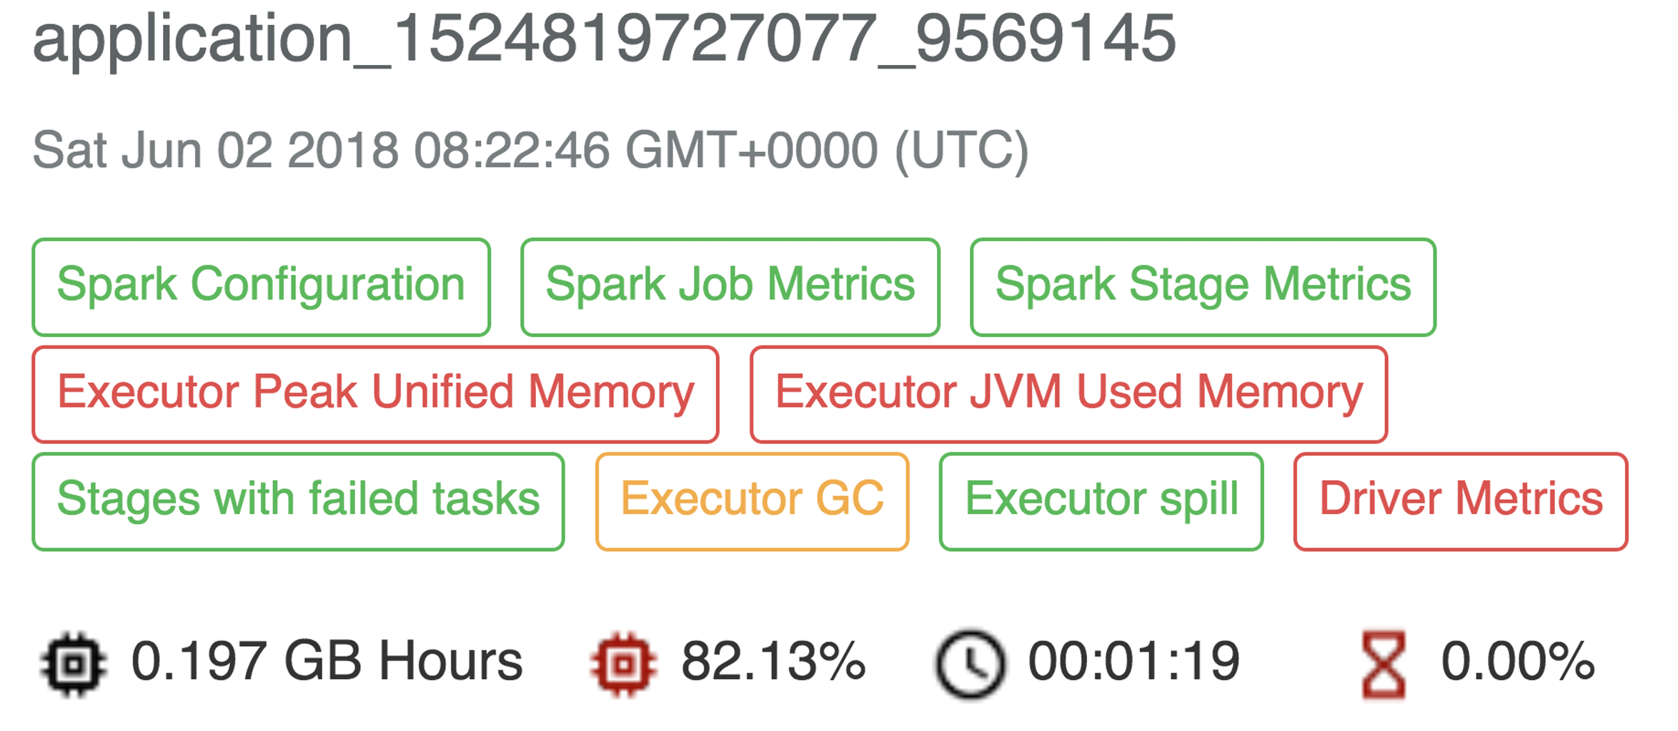

Slide 13

Why Auto Tuning?
10000s of jobs to tune
Increases developer productivity
Tunes without any extra effort
No expertise is expected
Option of which objective function to tune for
  resource usage
  execution time etc.

Slide 14

Let’s auto tune!
Photo: memecreator.org

Slide 15
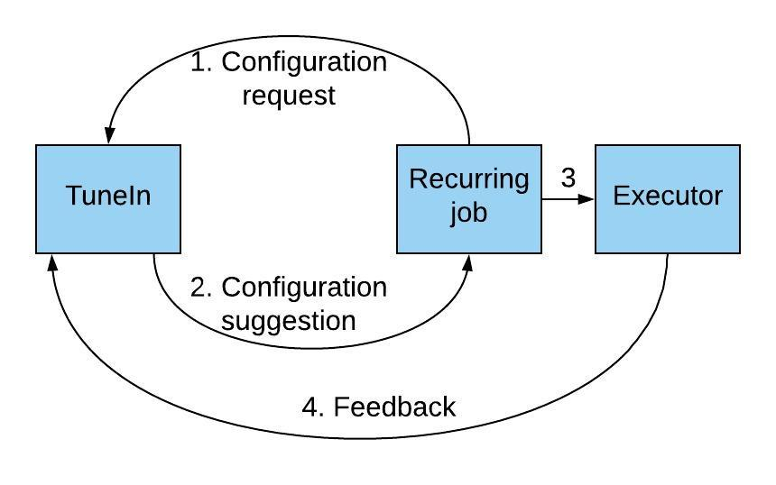
TuneIn
Framework to automatically tune recurring Hadoop and Spark jobs
Iteratively tries to reach the optimal configuration
Results : 20-35% reduction in Resource Usage

Slide 16
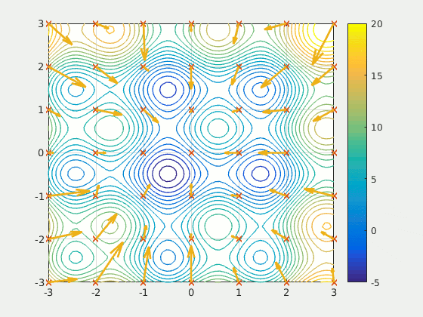
Particle Swarm Optimization (PSO)[1]
Mimics the behavior of swarm of birds searching food
Starts optimization by introducing particles at random positions in the search space
Source: Wikipedia
Particle Swarm Optimization by J. Kennedy et al., https://ieeexplore.ieee.org/document/488968/

Slide 17
PSO (contd.)
Points of attraction: personal and global best known positions
Particles converge to the region with the minimum cost function value
Source: Wikipedia

Slide 18
Why PSO?
Cost function is noisy
  PSO is gradient free and robust against noise [3]
Spark and Hadoop are complex systems
  PSO is a metaheuristic black box optimization algorithm
Fastest convergence
K. E. Parsopoulos et al., “Particle Swarm Optimizer in Noisy and Continuously Changing Environments,” in Artificial Intelligence and Soft Computing

Slide 19
PSO Details[2]
Swarm size of 3 gives the best result
  neither too small to cover the search space
  nor too big to do many first iteration random searches
Good starting point is important to guide the swarm
Optimizing Hadoop parameter settings with gene expression programming guided PSO by Mukhtaj Khan et al.

Slide 20
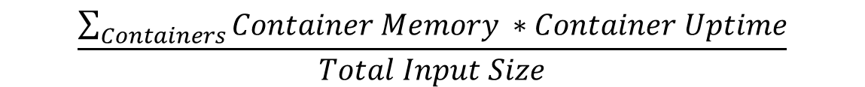
Cost function
Resource usage per unit input
Approximately input size invariant
$$\frac{\sum_{Containers}{Container Memory ∗Container Uptime}}{Total Input Size}$$

Slide 21
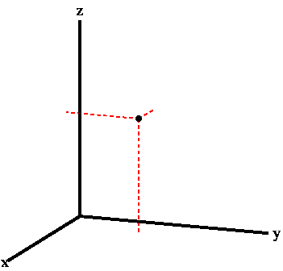
Search Space
Parameters being tuned constitutes the search space
Depends on the cost function metric
Param 3
Param 2
Param 1

Slide 22
Search Space
Cost function: Resource Usage
Pig | Spark
mapreduce.map.memory.mb | spark.executor.memory
mapreduce.reduce.memory.mb | spark.executor.cores
mapreduce.task.io.sort.mb | spark.memory.fraction
mapreduce.task.io.sort.factor | spark.yarn.executor.memoryOverhead

Slide 23
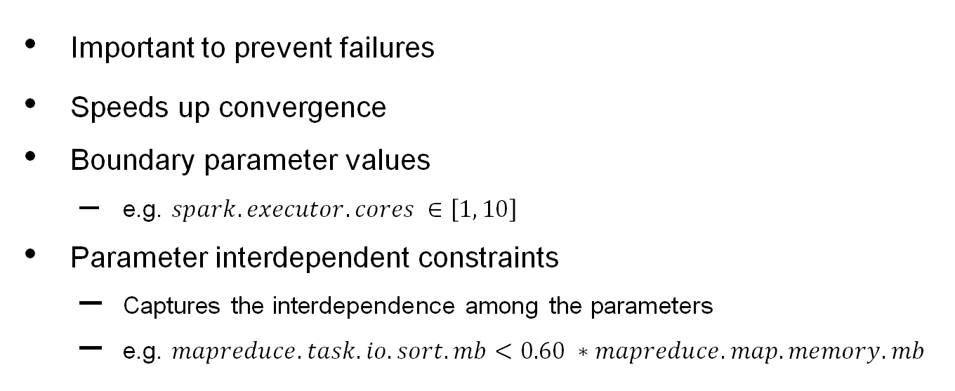
Search Space Reduction
Important to prevent failures
Speeds up convergence
Boundary parameter values
  e.g. $spark.executor.cores ∈\left[1, 10\right]$
Parameter interdependent constraints
  Captures the interdependence among the parameters
  e.g. $mapreduce.task.io.sort.mb<0.60 ∗mapreduce.map.memory.mb$

Slide 24
Search Space Reduction
Different jobs can have different optimal boundary values
Boundary values are tightened on the basis of previous job execution counters

Slide 25


Avoiding over optimization
Undesirable to squeeze memory so much that execution time shoots up significantly
Updated cost function:
$$\frac{\sum_{Containers}{Container Memory ∗Container Uptime}}{Total Input Size}+Penalty$$
Photo: Ian Burt

Slide 26
Convergence
No theoretical bound on the steps to converge
Practically converges in 20 job executions
TuneIn gets turned off for the job automatically on convergence

Slide 27
Results
Job type | Metric | Reduction range
Spark | Resource Usage | 30 - 40 % per job
Pig | Resource Usage | 20 - 35 % per job

Slide 28
Architecture

Slide 29




Framework Features
Tuning During Regular Scheduled Runs
Generic Framework
  Resource usage, execution time
  Pig, Hive, Spark
  Easy integration
Failure Avoidance
  Constraints on parameters
  Automatic failure handling
Auto Switch Off

Slide 30

Road Ahead
Heuristics based tuning
Tuning for execution time
Smarter tuning switch on/off
Photo: www.widehdimages.com

Slide 31
References
Particle Swarm Optimization by J. Kennedy et al., https://ieeexplore.ieee.org/document/488968/
Optimizing Hadoop parameter settings with gene expression programming guided PSO by Mukhtaj Khan et al.
K. E. Parsopoulos et al., “Particle Swarm Optimizer in Noisy and Continuously Changing Environments,” in Artificial Intelligence and Soft Computing

Slide 32
Happy tuning!
Document: https://github.com/linkedin/dr-elephant/wiki/Auto-Tuning
Code: https://github.com/linkedin/dr-elephant/pull/338

Slide 33
Appendix

Slide 34
Algorithms experimented with
Gradient descent
  Brute force
  Simultaneous perturbation
Gradient free methods
  Maximum likelihood region
  Genetic algorithm
  Differential evolution

Slide 35
Pig Interdependent Constraints
$mapreduce.task.io.sort.mb<0.6 ∗mapreduce.map.memory.mb$
$mapreduce.map.memory.mb −mapreduce.task.io.sort.mb>768$
$pig.maxCombinedSplitSize<1.8∗map.memory.mb$

Slide 36

Penalty Function
$$Penalty =3∗\frac{\max{Desired Resource Usage}}{Average Input Size}$$

